Slide 1
NFL Draft Outcome Data
Presented by Ryan Cannady

Slide 2
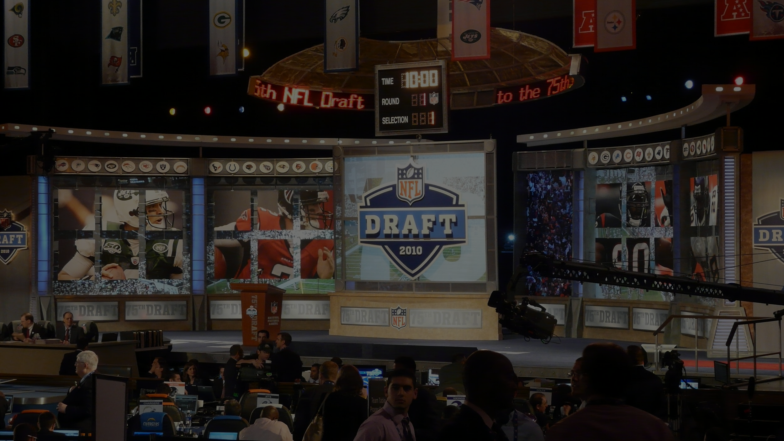
One of the most important parts of an
NFL teams success is through the draft!

Slide 3
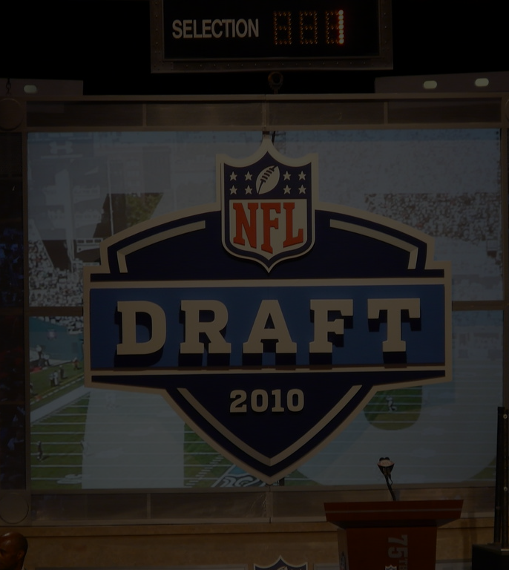
The Problem
It is very difficult to tell which players should get drafted and in what rounds.

Slide 4
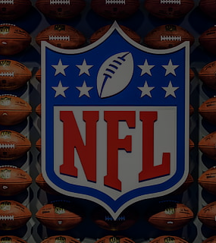
What is the solution?
A machine learning model a.k.a. Artificial Intelligence.

Slide 5
The data I found to solve this problem is from the NFL combine dating back to the year 2000 up until 2018

Slide 6
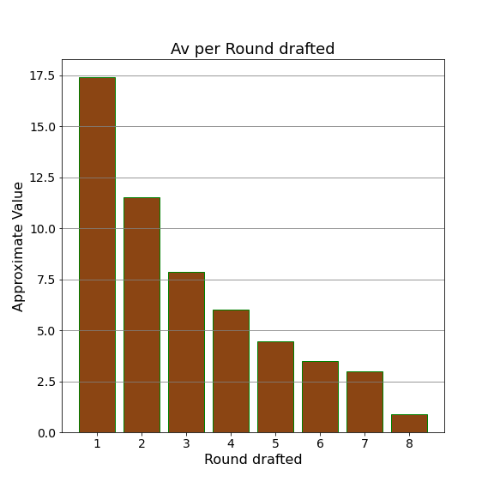
This bar graph shows
The average approximate value(AV)
Based on the round Drafted!

Slide 7
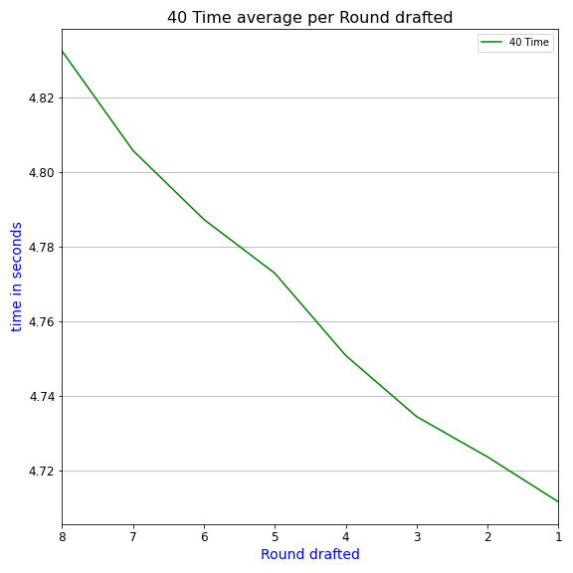
This line graph shows
The average 40 Time
Based on the round Drafted

Slide 8
The machine learning model I chose to put into production is called
LGBM(Light Gradient Boosted Machine)
LGBM is a model that uses Gradient boosting. Which is simply learning from its own errors and improving results.

Slide 9

In testing the lgbm model is right about 77 percent of the time

Slide 10
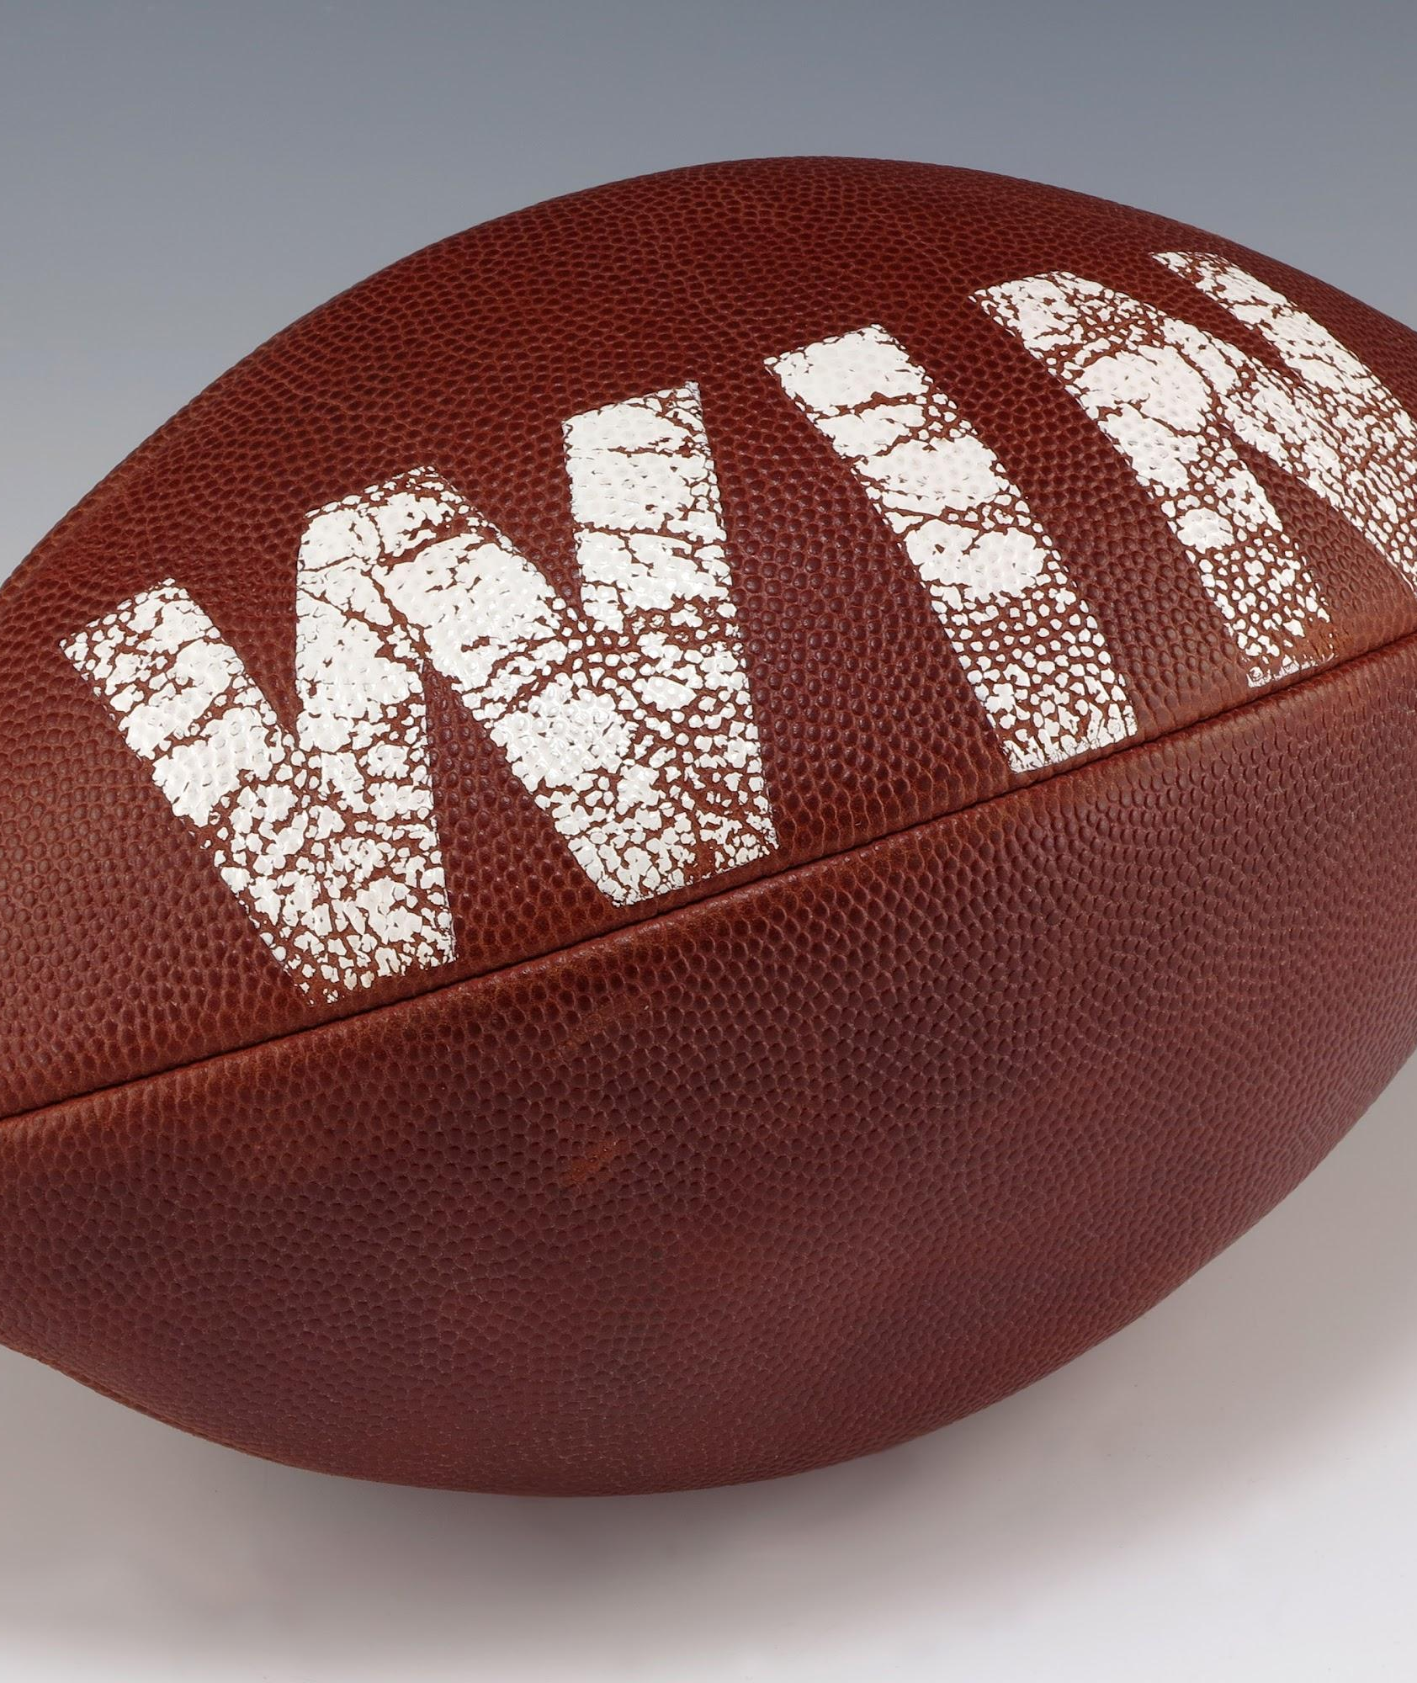
In Conclusion
Faster 40 times are valuable
Av is one of the most important indicators
There is always next year in the draft

